Slide 1

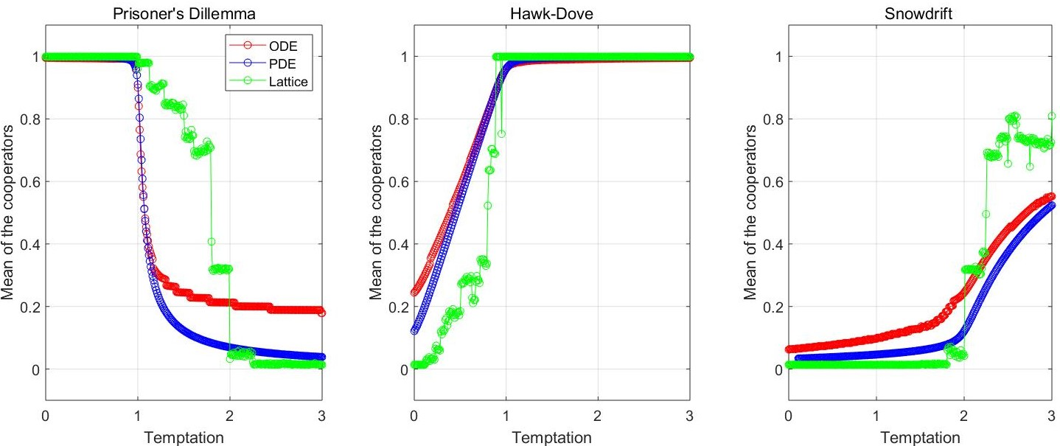
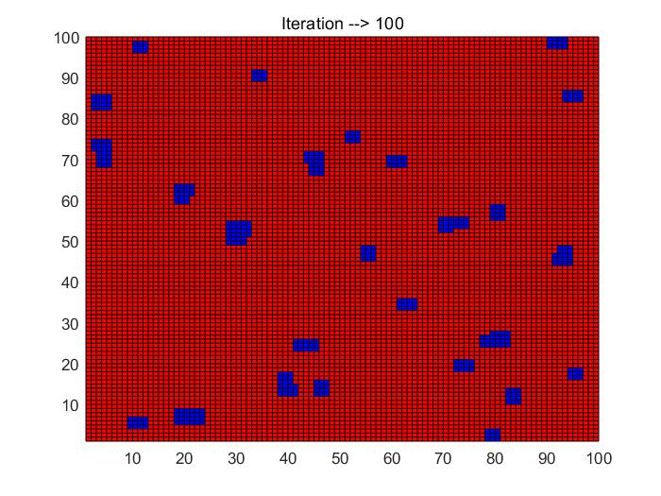
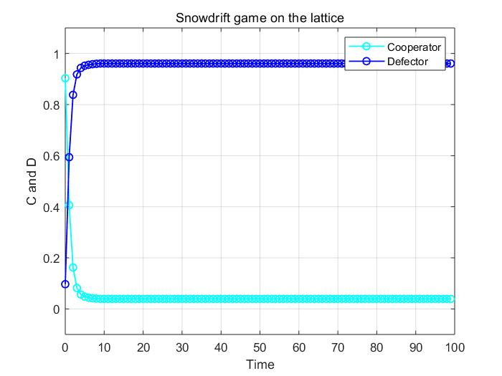
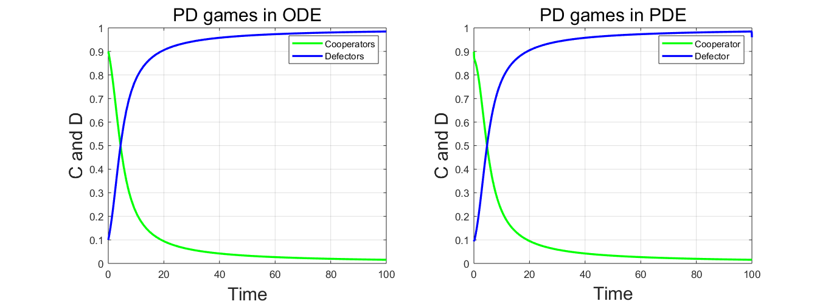
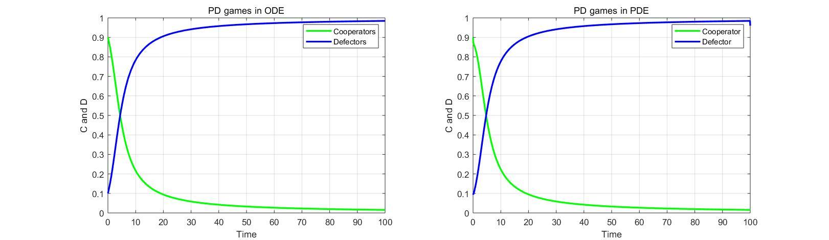
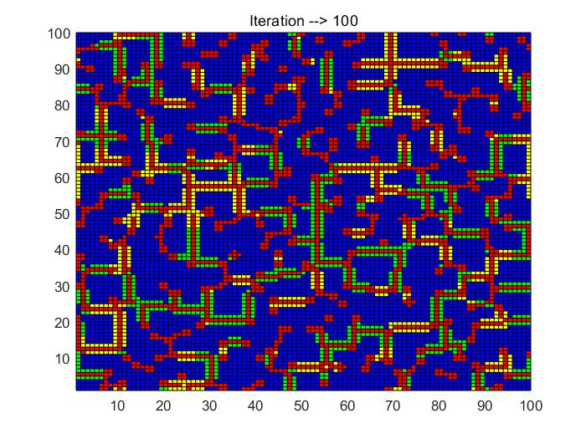
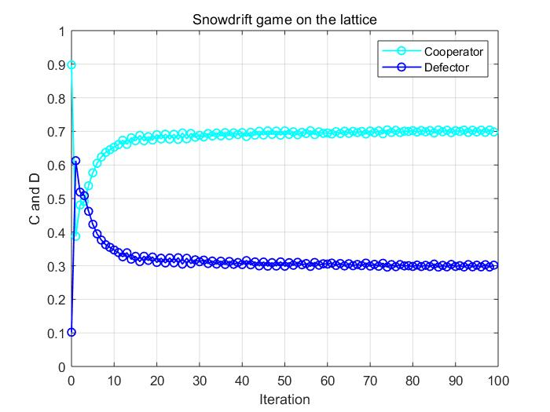
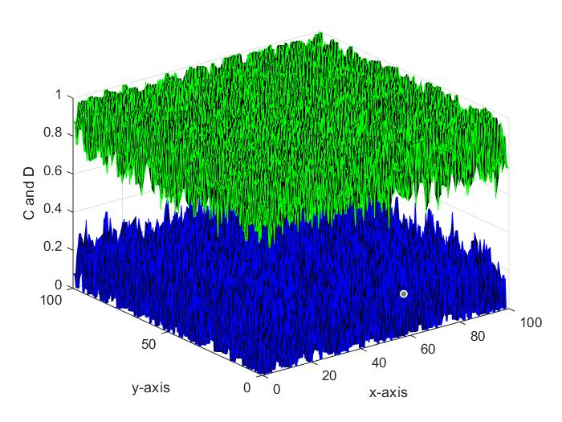
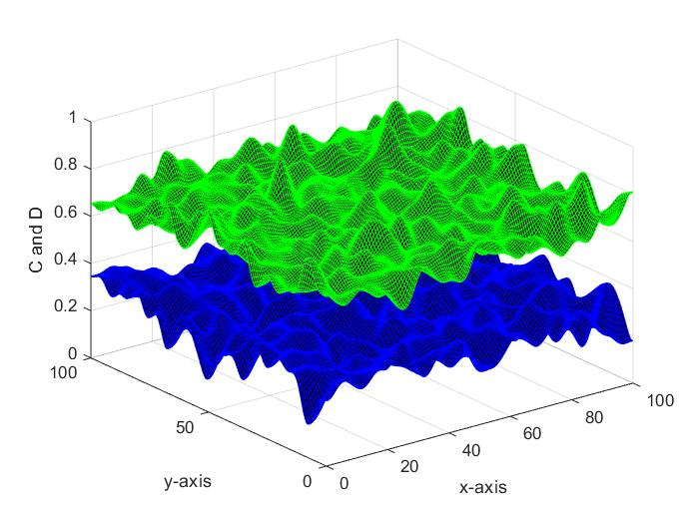
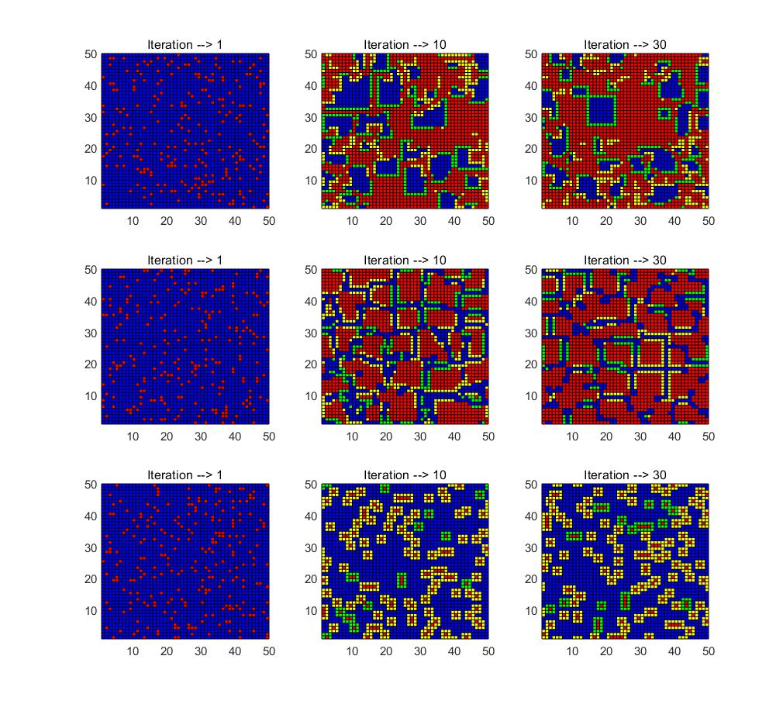
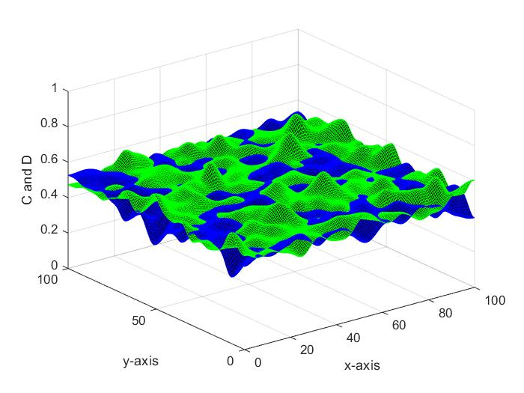
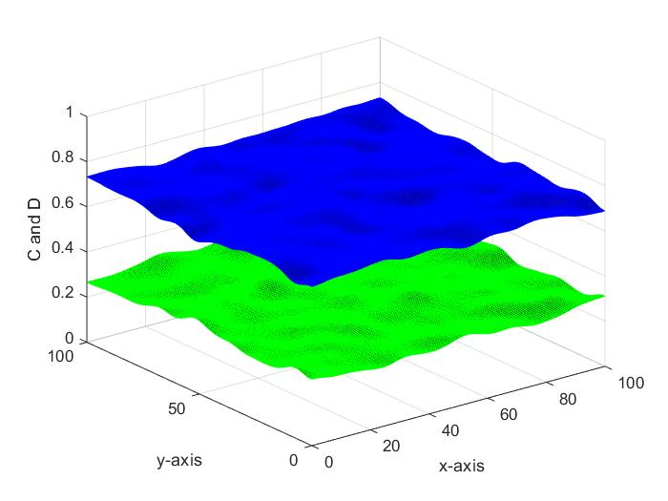
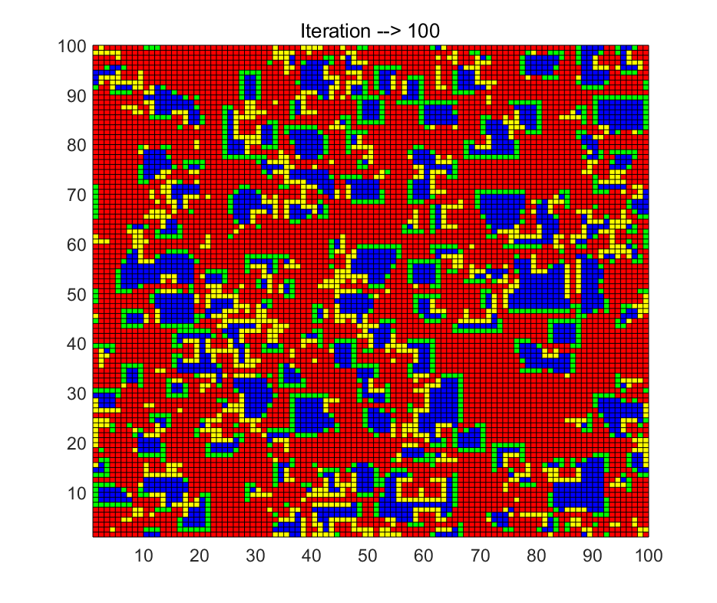
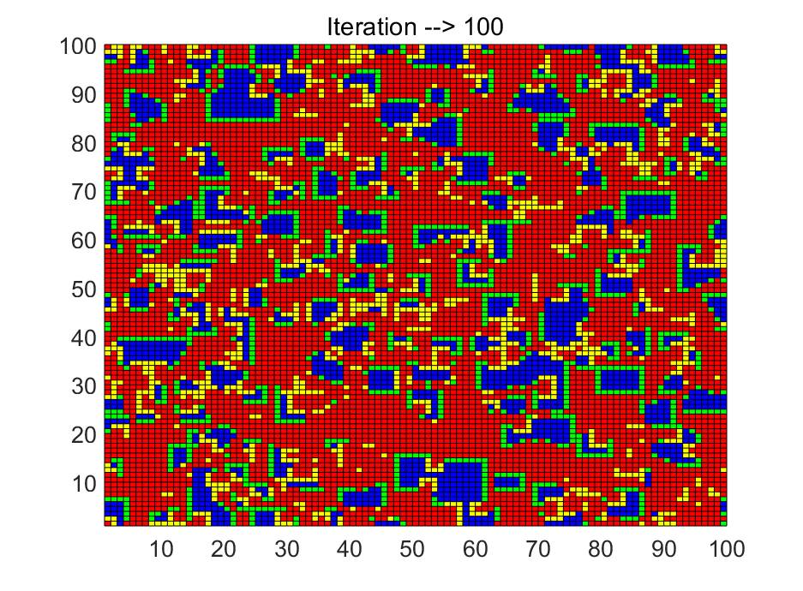
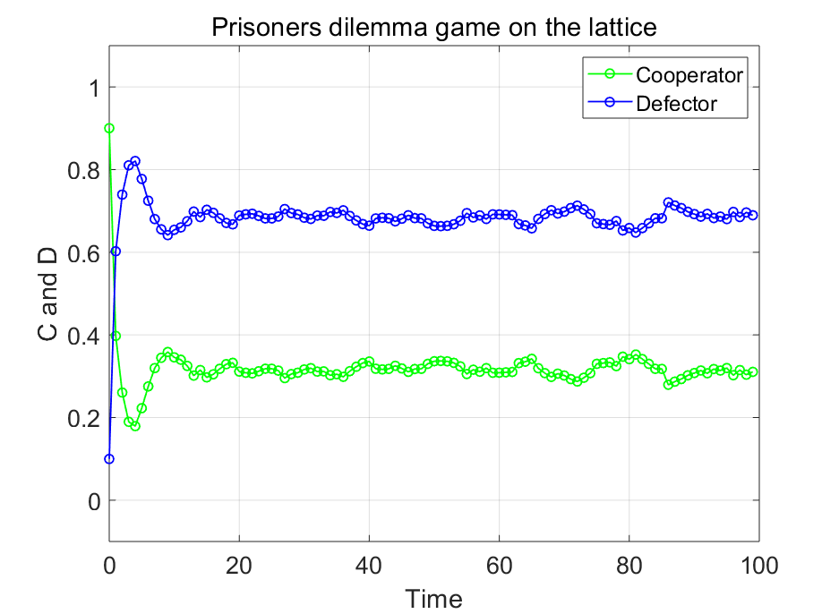
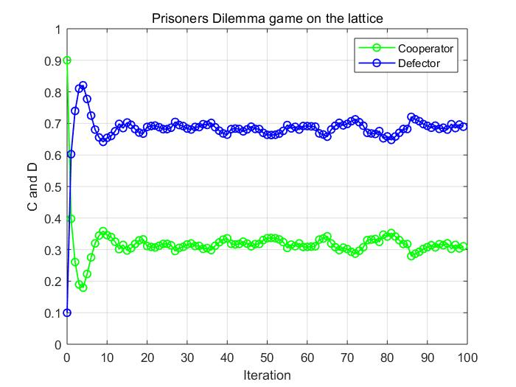
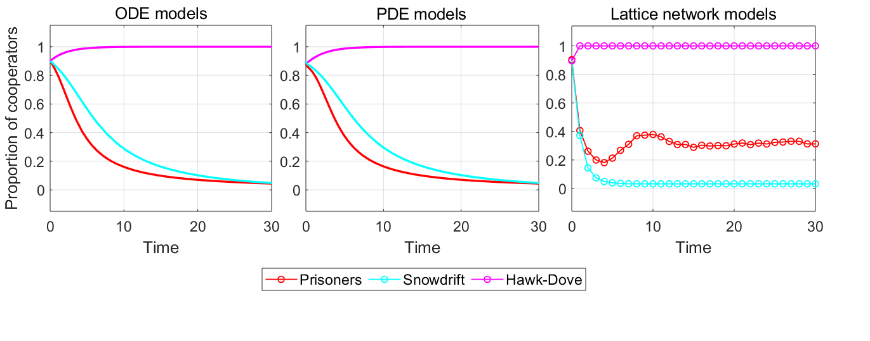
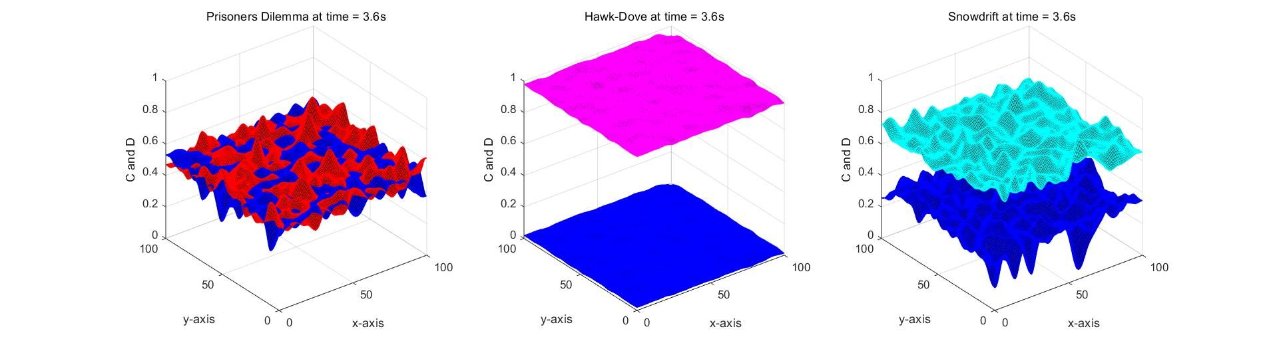


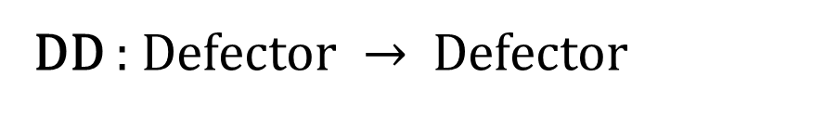
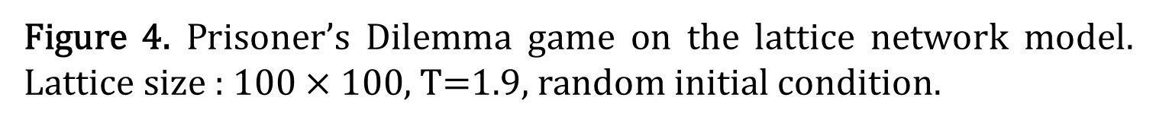
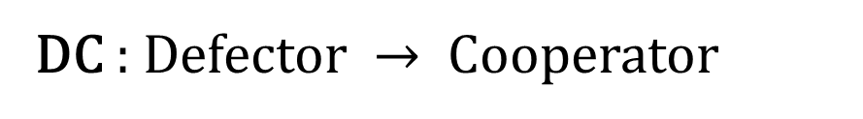
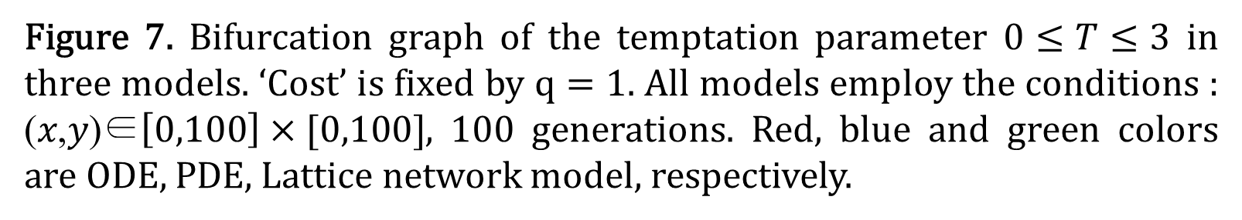


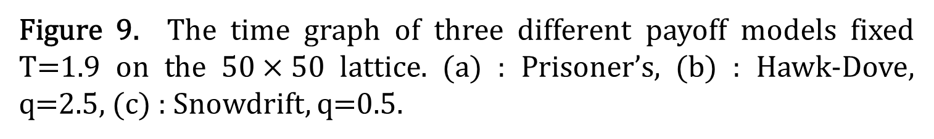
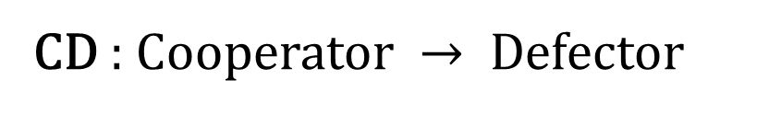
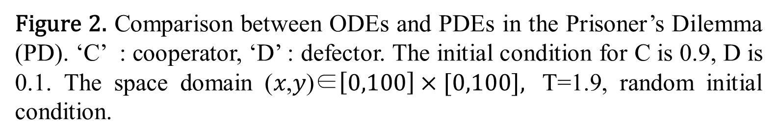
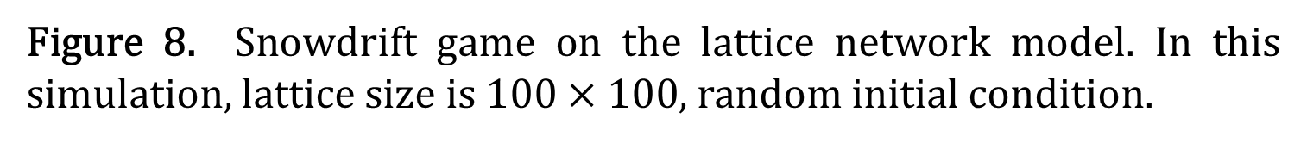
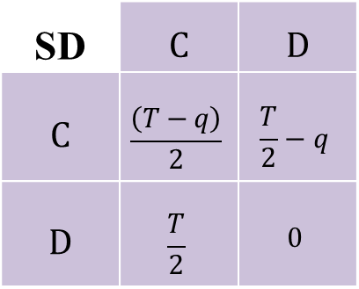

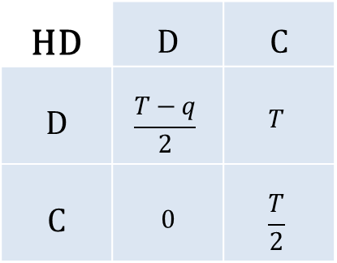
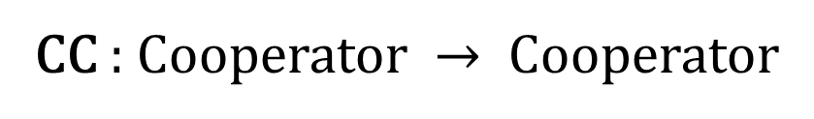
A STUDY OF SPATIAL DYNAMICS UNDER THE PRISONER’S DILEMMA, HAWK-DOVE AND SNOWDRIFT GAME Sangman Jung and Sunmi Lee Department of Applied Mathematics, Kyung Hee University, Yongin-si, South Korea
Background
3. Spatial structure : Lattice network model
We investigate the effects of three games on spatial dynamics: Prisoner’s Dilemma, Hawk-Dove and Snowdrift game.
We employ three different approaches including a lattice network model, replicator equations, and partial differential equations.
We study spatial dynamics under various conditions: different payoff, and initial configurations.
neighbor
neighbor
neighbor
Will be occupied by the player have the highest payoff in this round.
DC
CC
neighbor
Player
neighbor
Play the games
(one time-step)
DD
CD
neighbor
neighbor
neighbor
Random initial conditions :
Cooperator or Defector
In game theory, the payoff matrix is the result of the model of strategic interaction between rational decision-makers.
This model implies that the players obtained specific payoff when they play the game with each other, having their own's strategies.
We investigate the $2×2$symmetric games represented by the payoff matrix in game theory as follows.
CC : Cooperator $→$ Cooperator
DC : Defector $→$ Cooperator
Figure 7. Bifurcation graph of the temptation parameter $0≤T≤3$ in three models. ‘Cost’ is fixed by $q=1$. All models employ the conditions : (𝑥,𝑦)∈$\left[0,100\right]×[0,100]$, 100 generations. Red, blue and green colors are ODE, PDE, Lattice network model, respectively.
CD : Cooperator $→$ Defector
DD : Defector $→$ Defector
Figure 1. The rule of the game and color map when the strategy changing on $n×n$ lattice network model.
Numerical simulations
PD | C | D
C | R | S
D | T | P
HD | D | C
D | $$\frac{T−q}{2}$$ | $$T$$
C | 0 | $$\frac{T}{2}$$
SD | C | D
C | $$\frac{\left(T−q\right)}{2}$$ | $$\frac{T}{2}−q$$
D | $$\frac{T}{2}$$ | $$0$$
Prisoner’s Dilemma
Hawk-Dove
Snowdrift
(a) Snowdrift, T=1.9, q=1
Table 1. The payoff matrix of three different games
(a) ODEs (b) PDEs.
T : temptation, R : reward, P : punishment, S : sucker’s payoff, q : cost.
In this table 1, C : Cooperator, D : Defector. In Hawk-Dove game, D is a ‘Hawk’, C is a ‘Dove’, respectively.
These parameters are satisfied the inequality as
T > R > P $≥$ S
We set the values of the base parameters $T=1.9 ,q=1,$
$R=1$, $P=S=0$ and vary the parameters T and c.
Figure 2. Comparison between ODEs and PDEs in the Prisoner’s Dilemma (PD). ‘C’ : cooperator, ‘D’ : defector. The initial condition for C is 0.9, D is 0.1. The space domain (𝑥,𝑦)∈$\left[0,100\right]×[0,100],$ T=1.9, random initial condition.
(b) Snowdrift, T=1.9, q=0.8
Three different models
Figure 8. Snowdrift game on the lattice network model. In this simulation, lattice size is $100×100$, random initial condition.
Replicator equations
(Ordinary Differential Equations)
In evolutionary game theory, the replicator equation is the deterministic dynamics of a population. Let $x_{1}, x_{2}$ are the proportion of C and D such that $x_{1}+x_{2}=1$, then the system of the equations as follows.
Prisoner’s Dilemma
$${\dot{x}}_{1}=x_{1}^{2}\left(1−x_{1}−Tx_{2}\right)$$
$${\dot{x}}_{2}=x_{1}x_{2}\left(T(1−x_{2})−x_{1}\right)$$
Hawk-Dove game
$${\dot{x}}_{1}=x_{1}\left(\frac{T−q}{2}x_{1}\left(1−x_{1}\right)+Tx_{2}(1−x_{1}−\frac{x_{2}}{2})\right)$$
$${\dot{x}}_{2}=x_{2}\left(\frac{T}{2}x_{2}−\frac{T−q}{2}x_{1}^{2}−Tx_{1}x_{2}−\frac{T}{2}x_{2}^{2}\right)$$
Snowdrift game
$${\dot{x}}_{1}=x_{1}\left(\frac{T−q}{2}x_{1}\left(1−x_{1}\right)+\left(q−T\right)x_{1}x_{2}+(\frac{T}{2}−q)x_{2}\right)$$
$${\dot{x}}_{2}=x_{2}\left(\frac{T}{2}x_{1}\left(1−x_{1}\right)+\frac{q}{2}x_{1}^{2}+\left(q−T\right)x_{1}x_{2}\right)$$
(a) Time = 0.2 (b) Time = 4.1
(a)
(b)
(c) Time = 4.8 (d) Time = 8.9
Figure 3. Spatial Prisoner’s Dilemma (PDEs): mesh graph simulation of each time in figure 2.
(c)
Figure 9. The time graph of three different payoff models fixed T=1.9 on the $50×50$ lattice. (a) : Prisoner’s, (b) : Hawk-Dove, q=2.5, (c) : Snowdrift, q=0.5.
Discussions
2. Modified replicator equations
(Partial Differential Equations)
We obtain the system of partial differential equations by adding the Laplace operator $∆u=\frac{∂u}{∂x}+\frac{∂u}{∂y}$ when $u(x,y,t)$ in the replicator equations as follows.
Modified Prisoner’s Dilemma
$$\frac{∂u_{1}}{∂t}=∆u_{1}+u_{1}^{2}\left(1−u_{1}−Tu_{2}\right)$$
$$\frac{∂u_{2}}{∂t}=∆u_{2}+u_{1}u_{2}\left(T(1−u_{2})−u_{1}\right)$$
Modified Hawk-Dove game
$$\frac{∂u_{1}}{∂t}=∆u_{1}+u_{1}\left(\frac{T−q}{2}u_{1}\left(1−u_{1}\right)+Tu_{2}(1−u_{1}−\frac{u_{2}}{2})\right)$$
$$\frac{∂u_{2}}{∂t}=∆u_{2}+u_{2}\left(\frac{T}{2}u_{2}−\frac{T−q}{2}u_{1}^{2}−Tu_{1}u_{2}−\frac{T}{2}u_{2}^{2}\right)$$
Modified Snowdrift game
$$\frac{∂u_{1}}{∂t}=∆u_{1}+u_{1}\left(\frac{T−q}{2}u_{1}\left(1−u_{1}\right)+\left(q−T\right)u_{1}u_{2}+(\frac{T}{2}−q)u_{2}\right)$$
$$\frac{∂u_{2}}{∂t}=∆u_{2}+u_{2}\left(\frac{T}{2}u_{1}\left(1−u_{1}\right)+\frac{q}{2}u_{1}^{2}+\left(q−T\right)u_{1}u_{2}\right)$$
Figure 4. Prisoner’s Dilemma game on the lattice network model. Lattice size : $100×100$, T=1.9, random initial condition.
We obtain the results that the spatial structure affects the proportion of the cooperators but the convergence behavior is similar between the models we suggest.
In Hawk-Dove and Snowdrift game, both games get opposite results depending on the value of $q$, and opposite patterns on the spatial graph.
Unlike other games, the proportion of C of the Prisoner’s Dilemma is always converged to zero but does not converge to zero on the lattice.
The results show that the spatial structure affects the proportion of the cooperators, however qualitative behavior is similar in all models.
In Hawk-Dove and Snowdrift game, both games get opposite results depending on the value of $q$, and opposite patterns on spatial patterns.
There is a discrepancy between the proportion of the cooperators of all three games (from ODE/PDE models) and the one from the lattice model.
In fact, the difference in the proportion of the cooperators mentioned above is dependent on $T$ and $q$.
Prisoner's dilemma, Hawk-Dove, and Snowdrift game show different spatial patterns, hence, different the proportion of the cooperators.
Figure 5. Comparison of ODE, PDE and Lattice network models in three games. The red color is the Prisoner’s Dilemma, cyan and magenta are Snowdrift, Hawk-Dove, respectively. The curve represents the distribution of the cooperator in population. The parameters are q=1, T=1.9.
References
[1] Nowak, M. A., & May, R. M. (1992). Evolutionary games and spatial chaos. Nature, 359(6398), 826.
[2] Hauert, C., & Doebeli, M. (2004). Spatial structure often inhibits the evolution of cooperation in the snowdrift game. Nature, 428(6983), 643.
[3] Voelkl, B. (2010). The ‘Hawk-Dove’game and the speed of the evolutionary process in small heterogeneous populations. Games, 1(2), 103-116.
[4] Killingback, T., & Doebeli, M. (1996). Spatial evolutionary game theory: Hawks and Doves revisited. Proceedings of the Royal Society of London. Series B: Biological Sciences, 263(1374), 1135-1144.
(a) Prisoner’s Dilemma (b) Hawk-Dove (c) Snowdrift
[5] Park, J., Do, Y., Jang, B., & Lai, Y. C. (2017). Emergence of unusual coexistence states in cyclic game systems. Scientific reports, 7(1), 7465.
Figure 6. Mesh graphs of time=3.6s. : the blue is the distribution of defectors and the red, magenta and cyan color are of cooperators.
[6] Szabó, G., & Tőke, C. (1998). Evolutionary prisoner’s dilemma game on a square lattice. Physical Review E, 58(1), 69.

